Slide 1
Gettin’ Griddy With IT
Using CSS Grid and Flexbox

Slide 2

Stephen Fornal
Fort Worth, TX
@mr_fornal
stephen.fornal@tccd.edu

Slide 3
Layouts for Web
Where We Came From
Multi-column layouts are a common feature of web design
CSS originally didn’t have a way to align things in columns
Much of the CSS we learned in the past was about creatively abusing things to build columnar layouts

Slide 4

Floats
Block 1
Block 2
Block 3
.wrap {
  margin: 0 -10px;
  }
  .wrap li {
  float: left;
  width: calc(33.333% - 20px);
  margin: 10px;
  }

Slide 5
Solutions
Hacks, Frameworks, Etc.
Fixing the column problems leads to a lot of creative CSS
Clear fixes
  Extra Elements, pseudo elements
Inline-block
  Fragile, white space sensitive
Tables in CSS
  Equal heights, anonymous elements, border spacing

Slide 6
Solutions pt. 2
Hacks, Frameworks, Etc.
Tools to simplify and automate
Frameworks like Bootstrap, Foundation, etc
CSS Pre and Post Processors
  SASS
  LESS
  PostCSS (inc. Autoprefixer)

Slide 7
The Flexible Box Module
Flexbox FTW!
Boxes all in a row (or column)
Easy and powerful, flexible sizes for content
Layout on a single axis (even when it looks like a grid)
.wrap {
display: flex;
flex-direction: row; /* Default */
flex-wrap: nowrap; /* Default */
  }
  .wrap li {
  flex: 1 1 auto;
  }

Slide 8
Example One

Slide 9
Alignment in Flexbox
flex-direction: row;
Cross Axis
Main Axis
flex-direction: column;
Main Axis
Cross Axis

Slide 10
Alignment in Flexbox pt. 1
Use the align-items and align-self properties to control alignment
These work on the cross axis of the flexible box
Defaults to stretch, which gets those equal height boxes we love

Slide 11
Alignment in Flexbox pt. 2
Use the justify-content property to space items apart
This works on the main axis of the flexible box
Defaults to flex-start, which puts everything at the beginning of the box
There’s also some cool “magic” you can do with margin values set to auto

Slide 12
Example Two

Slide 13
The Grid Module
The Game Changer
Like Flexbox… but positioning in two dimensions
Grid layout creates tracks for the rows and columns of a grid
Elements of the grid can be positioned in the areas created by these intersecting tracks
There are many versatile ways to define and work with grid positioning

Slide 14
Grid
Block 1
Block 2
Block 3
Block 4
Block 5
.grid {
  display: grid;
  grid-template-columns: 200px 200px 200px;
  }
  .grid li {
  margin: 10px;
  }

Slide 15
Grid pt. 2
Block 1
Block 2
Block 3
Block 4
Block 5
.grid {
  display: grid;
  grid-template-columns: 1fr 1fr 1fr;
  grid-gap: 20px;
  }

Slide 16
Column/Row Sizing
Sizes can be explicit values
Sizes can be the special fractional value
Use the fr unit
Fractional units absorb and proportionally divide the available space

Slide 17
Repeat Syntax
Make many Columns easily
To generate a series of rows/columns, use the repeat syntax
grid-template-columns: repeat(3, 1fr);
grid-template-rows: repeat(4, 200px);
The first parameter is the quantity, the second parameter is the size

Slide 18
Example Three

Slide 19
Grid Positioning
Elements in a grid can be positioned by row and column, instead of being automatically placed
Column and row lines are numbered starting at 1
Can be specified from the opposite end using negative values
  For example, the last column line is -1
To specify a starting and ending position, use a forward slash between values

Slide 20
Grid Positioning pt. 2
.grid {
display: grid;
grid-template-columns: 1fr 1fr 1fr;
/* Creates lines 1 through 4 */
grid-gap: 20px;
  }
  .block1 {
  grid-column: 1 / 3;
  grid-row: 1;
  }
  .block2 {
  grid-column: 3;
  grid-row: 1 / 2;
  }
  .block3 {
  grid-column: 1 / 2;
  grid-row: 2;
  }

Slide 21
Grid Positioning pt. 3
You can specify auto as a positioning value, meaning it will be placed by source order in the next available track
You can specify end position using the span keyword to specify how far to extend
  .block1 {
  grid-column: 1 / 3;
  }
  .block2 {
  grid-column: auto / span 2;
  }

Slide 22
Example Four

Slide 23
Grid Template Area
A Fun Way to Build a Grid
You can build a grid using named areas
Grid children can be positioned on the grid using those names
Makes for super easy layout prototyping!
It’s kind of fun, haha

Slide 24
Grid Template Areas
.grid {
display: grid;
grid-gap: 20px;
grid-template-columns: repeat(3, 1fr);
grid-template-rows: repeat(4, 100px);
grid-template-areas:
“a a b”
“a a c”
“d d c”
“e e e”;
  }
  .block1 { grid-area: a; }
  .block2 { grid-area: b; }
  .block3 { grid-area: c; }
  .block4 { grid-area: d; }
  .block5 { grid-area: e; }

Slide 25
Example Five

Slide 26
Responsive by Default
Best News Ever!
Grid has powerful tools to be responsive by default
The properties grid-auto-rows and grid-auto-columns allow you specify a size for the implicit grid
These are rows and columns that are generated as needed, when the tracks are full
As a matter of fact, when we didn’t declare a template for rows in the early examples, we were getting the default grid-auto-rows value, auto

Slide 27
Responsive by Default pt. 2
Best News Ever!
A more versatile solution for responsive columns lies in the magic of the repeat() syntax, and some special keywords that can be used there
auto-fill is a keyword that means “make as many columns as possible”. It replaces the quantity parameter
minmax([min], [max]) is a keyword that replaces the size parameter

Slide 28
Responsive by Default pt. 3
Wait, explain this better…
This little snippet creates a grid layout of as many 300px columns as can fit in the grid container
If there’s leftover room, it gets divided evenly among the columns
.grid {
display: grid;
grid-gap: 20px;
grid-template-columns:
repeat(auto-fit, minmax(300px, 1fr);
}

Slide 29
Example Six

Slide 30
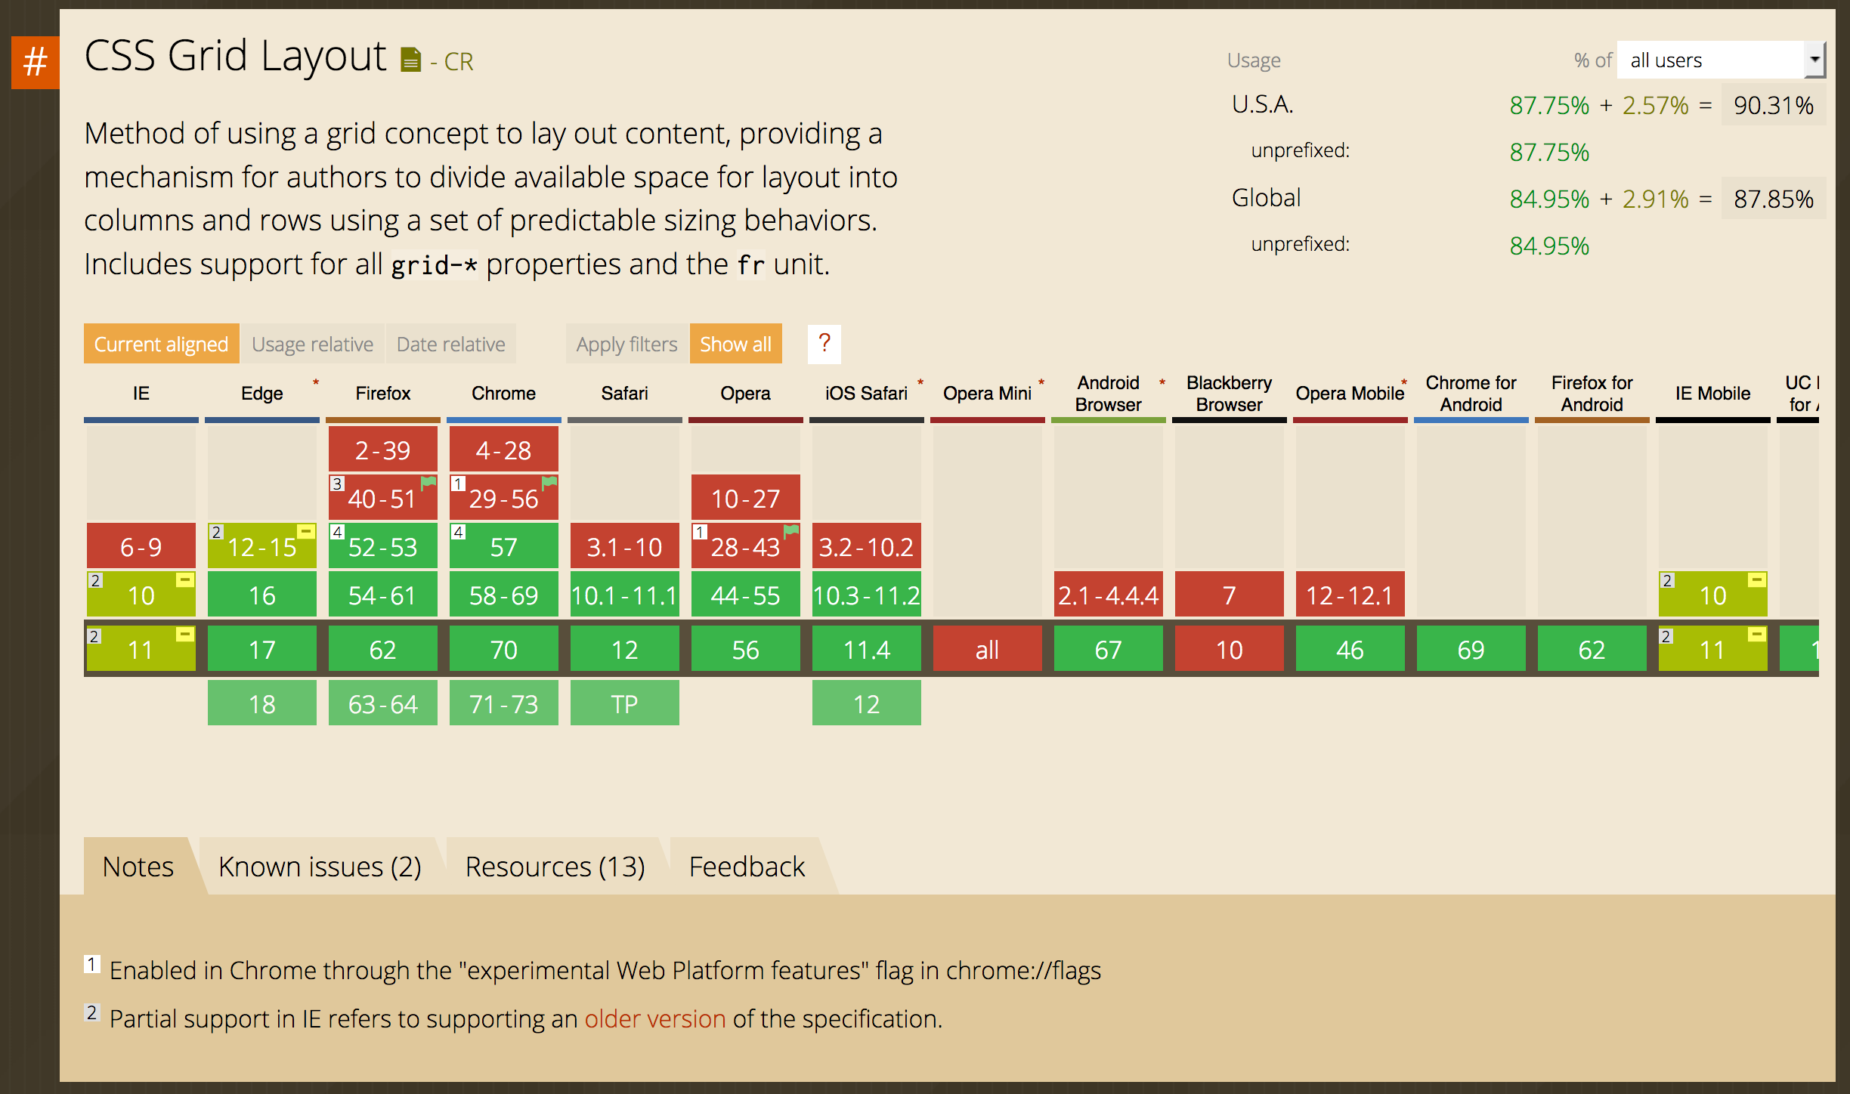
Current Support
Plug Your Own Analytics into caniuse.com

Slide 31
Can I Use This Now?
Yep!
Browser support is pretty good, and getting better!
Evergreen browsers are on top of it, and mobile browsers, too
Old IE has a working version of an earlier spec, usable with vendor prefixes. Or just give that browser the non-grid fallback
Speaking of fallbacks…

Slide 32
Fallbacks
Use Grid now, and provide sane fallbacks for older browsers
Many grid properties work fine alongside traditional box model properties
Some grid code that doesn’t play well can be hidden
/* Base-line CSS for base level experience here */
@supports (display: grid) {
/* Stash all your grid code in here */
}

Slide 33
Questions and Suggested Reading

Slide 34
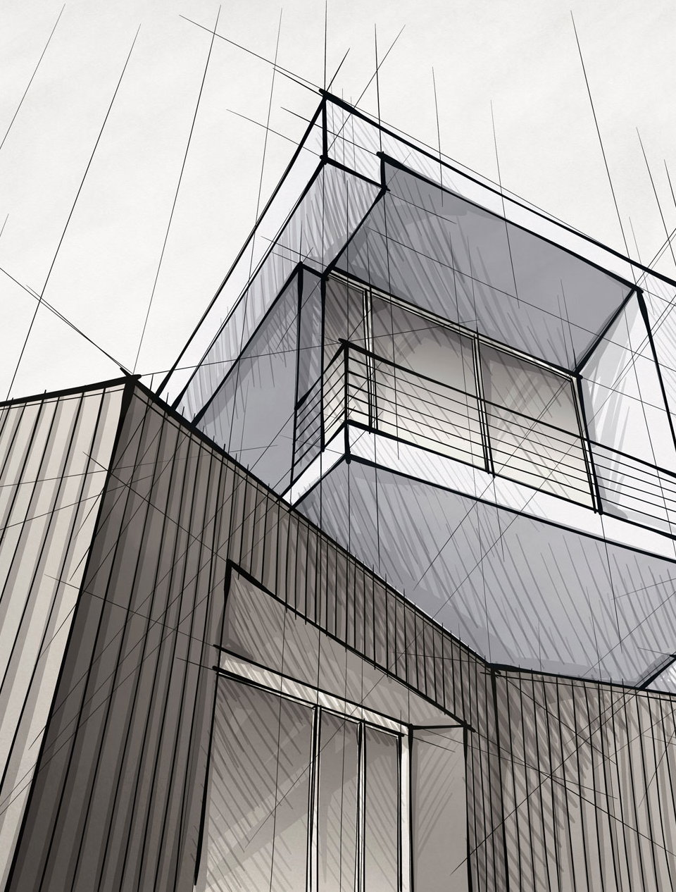
The
New CSS Layout
Rachel Andrew

Slide 35
Thank You!

